Slide 1
LINEAR REGRESSION
LOGISTIC REGRESSION
DSIA-SYD-FT-201907
PRESENT GROUP:
BOB WONG, WEINA ZHU
DATE: FRIDAY, 26 JULY 2019

Slide 2
Linear regression
The fundamental concept is that finding a best fit point for the output (dependent variable, y) from either one or multiple input data (independent variables, x)

Slide 3
SIMPLE & MULTIPLE LINEAR REGRESSION
Choose Only One or Multiple Features (Independent Variable(s), X ) to design a model which can minimize the squared error get predicted results (E(y)) close to the mean of the outputs (y) for the given inputs (x).

Slide 4
LOGISTIC REGRESSION
Have estimator classes with the Cross-Validation common used in splitting training data to simulate the out-of-sample-prediction, based on the model accuracy score like the Mean Squared Errors (“MSE”) and avoid overfitting the sample training data.

Slide 5
MULTIVARIATE LINEAR REGRESSION
Is the Multivariate Variable Analysis (“MVA”) which is based on the Multivariate Statistics and analyze for a multiple outcome variable at one time, and take into account of all variables on the responses of interest, typically used in Capability design, Inverse-design (turning a variable into an independent variable), Analysis of Alternatives, Identifying critical design-drivers.

Slide 6
SIMPLE LINEAR REGRESSION - ALGORITHM
y=mx + b
y= ℬ₀ +ℬ₁x +e
ℬ₀ = y-intercept population parameter
ℬ₁ = slope population parameter
e = error term, unexplained variation in y

Slide 7
SIMPLE LINEAR REGRESSION (CONT’D)
E(y) = ℬ₀ +ℬ₁x
E(Y) is the mean or expected value of y, for a given value of x
the mean of the distribution, the value of E(y) isn't really the point rather the MEAN of the best fit point
when Slope ℬ₁ is 0 the slope ℬ₀ would be flat in the middle (of the best fit mean line),
when Slope ℬ₁ is positive ℬ₀ increasing rising up line
when Slope ℬ₁ is negative ℬ₀ a decreasing line

Slide 8
Logistic Regression
the logistic model (or logit model) is used to model the probability of a certain class or event existing such as pass/fail, win/lose, alive/dead or healthy/sick. This can be extended to model several classes of events such as determining whether an image contains a cat, dog, lion, etc... Each object being detected in the image would be assigned a probability between 0 and 1 and the sum adding to one.

Slide 9
Logistic Regression
Logistic regression is a statistical model that in its basic form uses a logistic function to model a binary dependent variable, although many more complex extensions exist. In regression analysis, logistic regression (or logit regression) is estimating the parameters of a logistic model (a form of binary regression).
Mathematically, a binary logistic model has a dependent variable with two possible values, such as pass/fail which is represented by an indicator variable, where the two values are labeled "0" and "1".

Slide 10
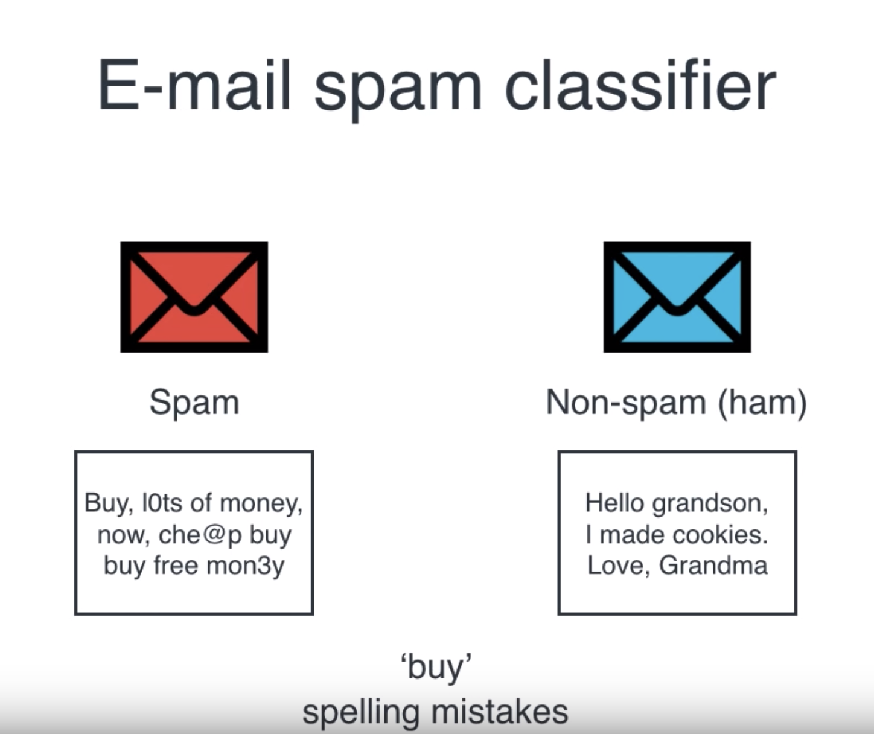
Simple Example (Logistic Regression)
Here, in this case, two features will be conducted:
Number of ‘buy’
Spelling mistakes
Reference:
https://www.youtube.com/watch?v=jbluHIgBmBo&list=LLVyxs0iWtODww_8yV-Az68g&index=6&t=0s

Slide 11
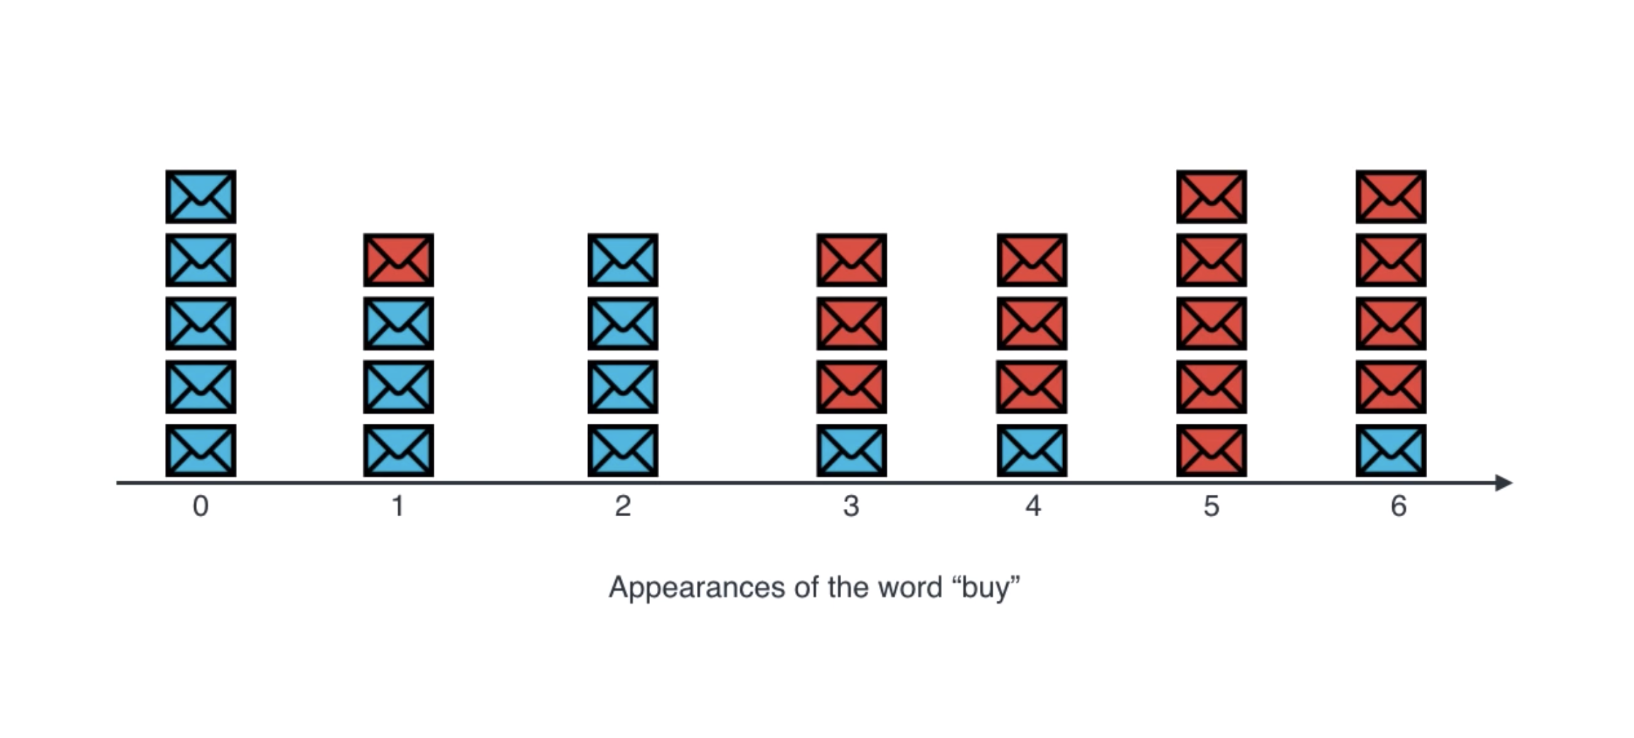
Logistic Regression Example (E-mail)

Slide 12
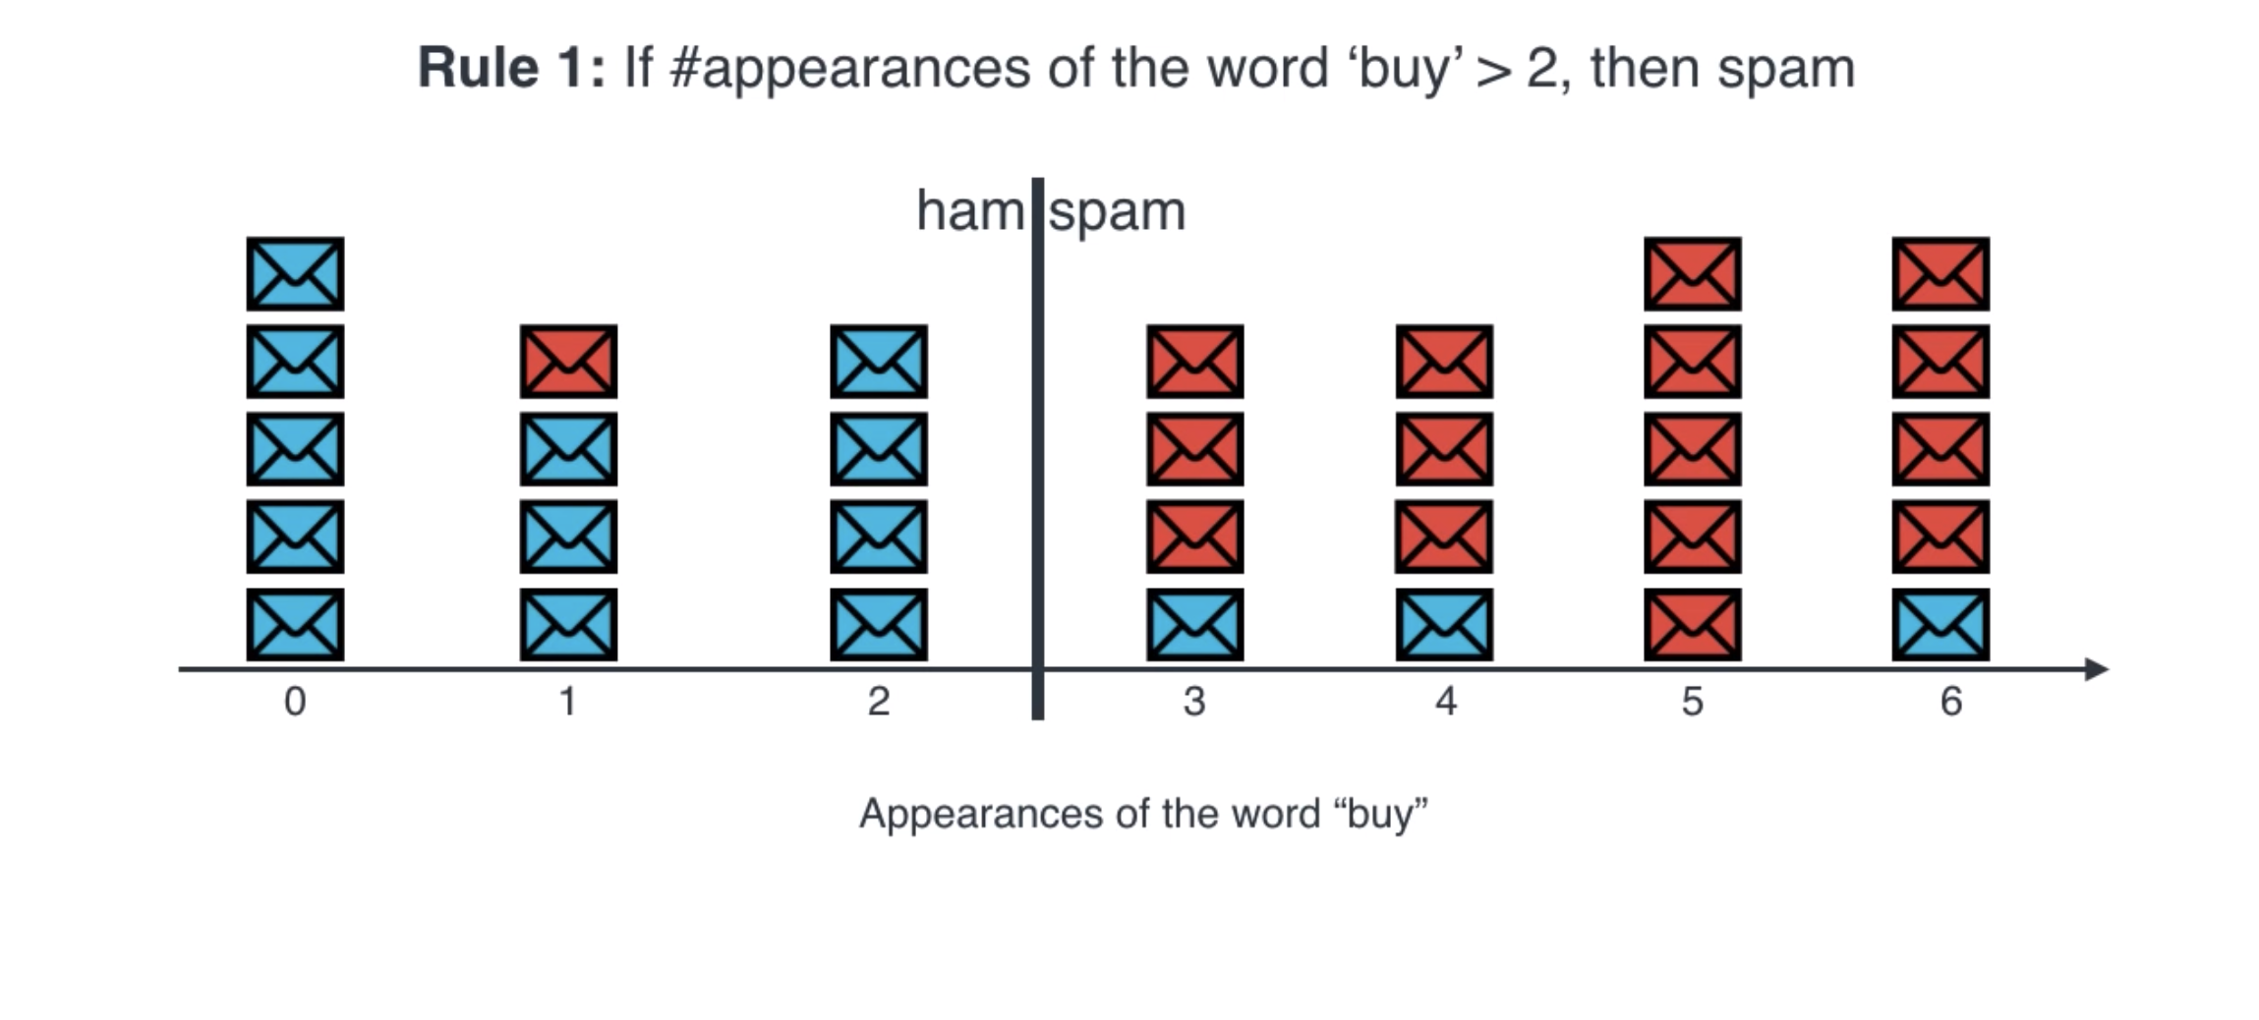
Logistic Regression Example (E-mail)

Slide 13
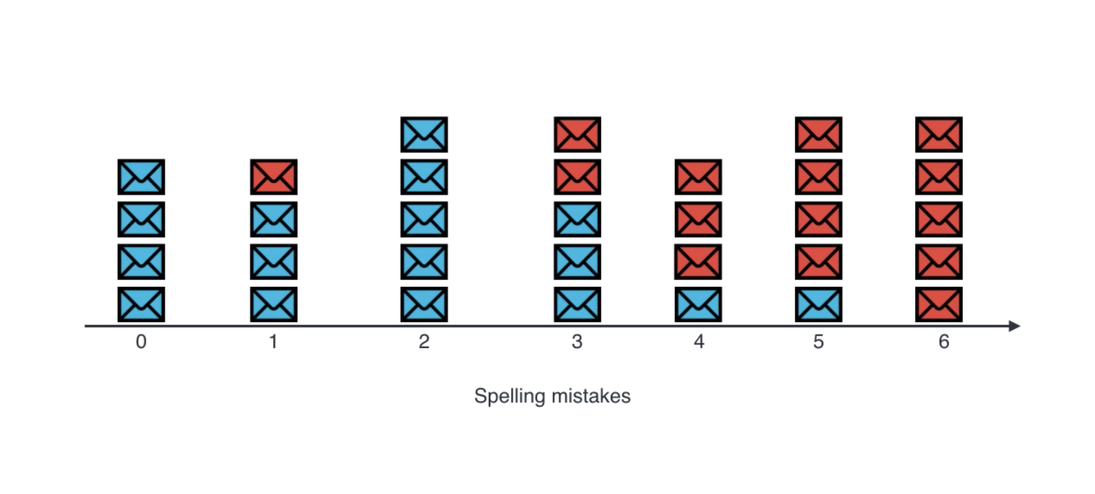
Logistic Regression Example (E-mail)

Slide 14
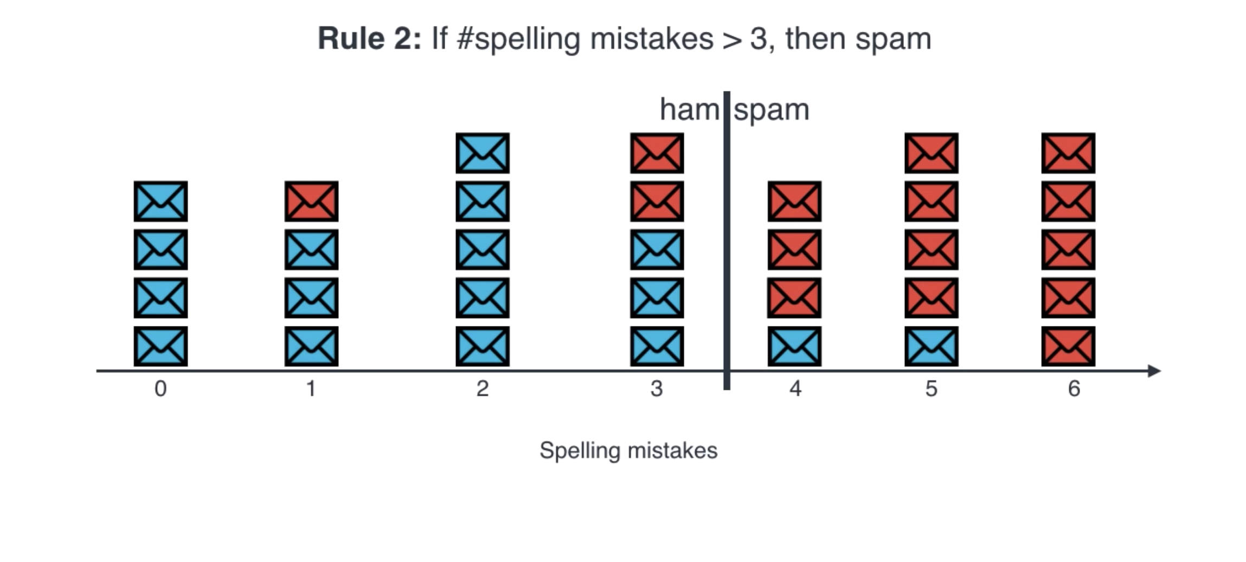
Logistic Regression Example (E-mail)

Slide 15
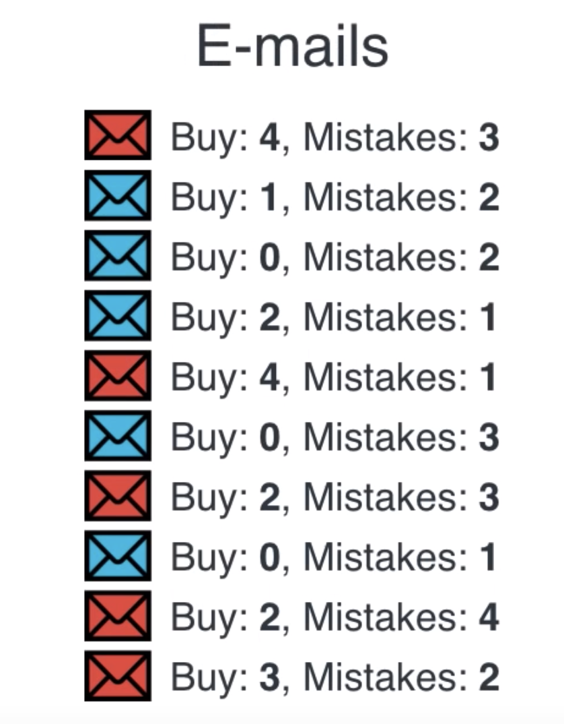
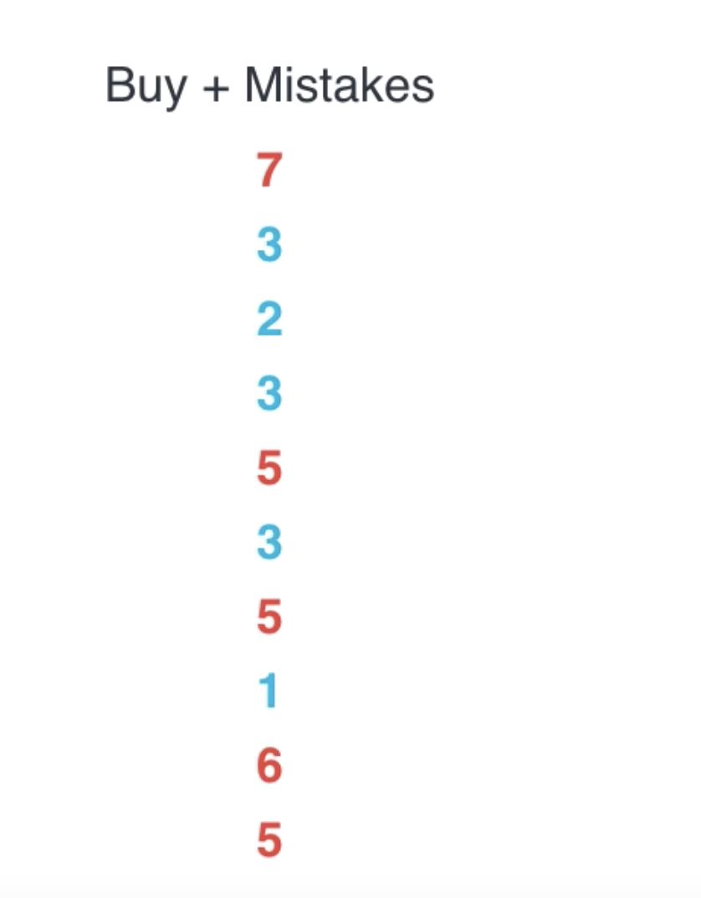
Logistic Regression Example (E-mail)
If
#buy + #spelling mistake > 4
Spam!!!

Slide 16
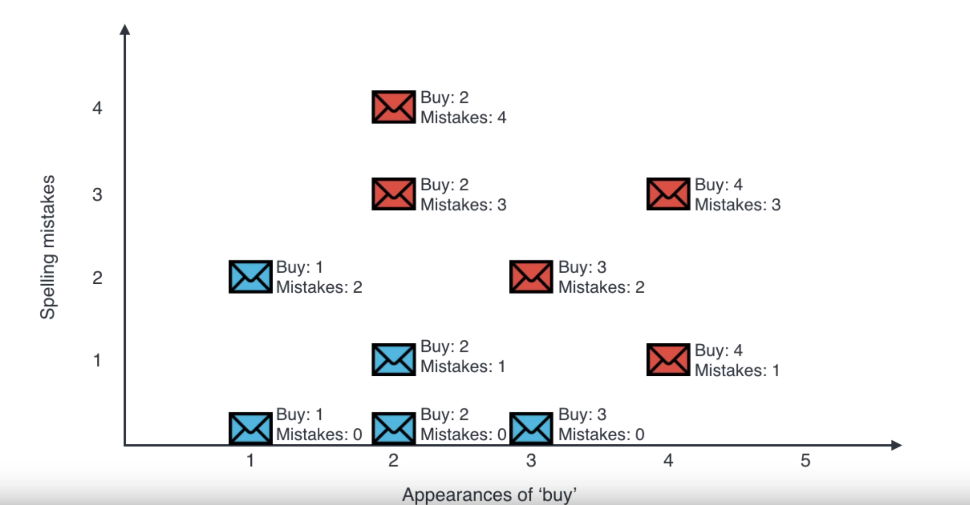
Logistic Regression Example (E-mail)

Slide 17
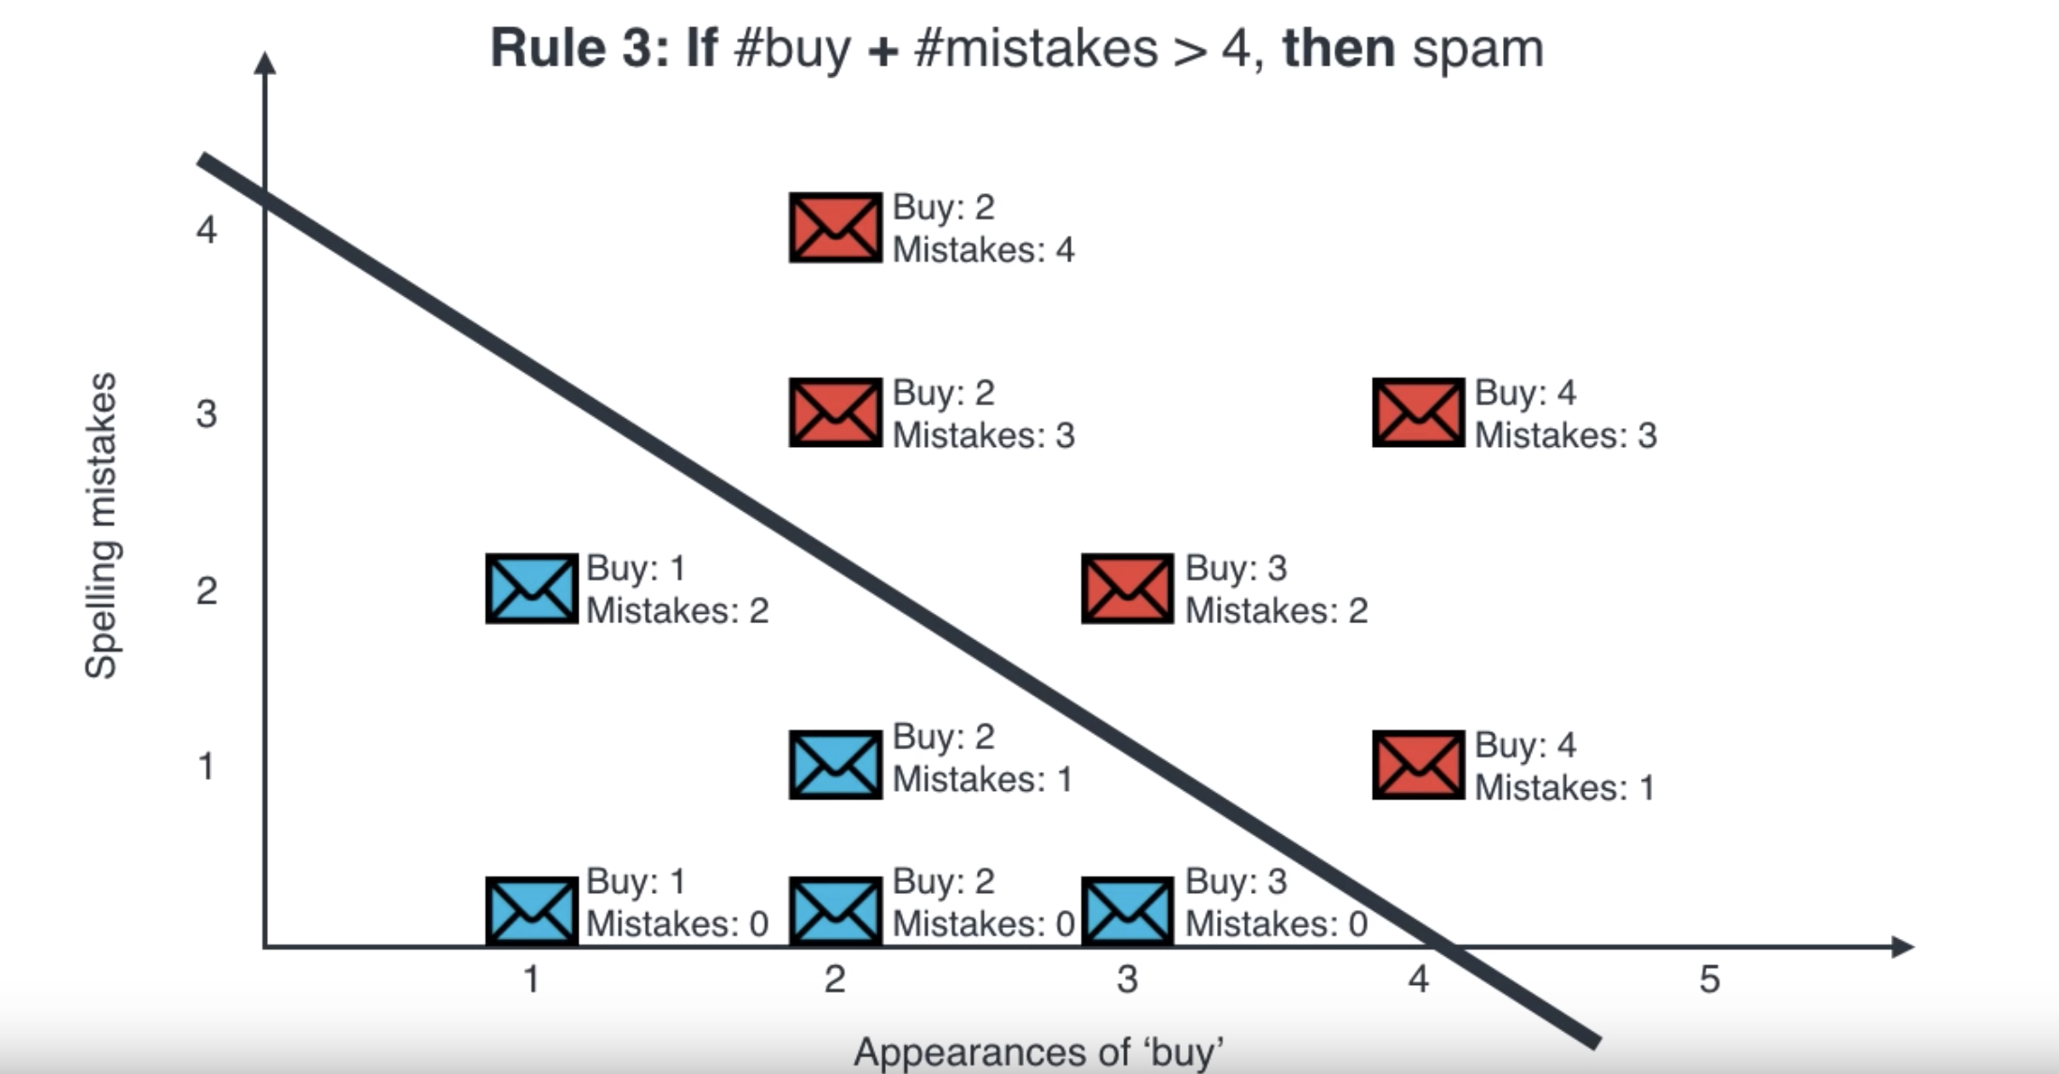
Logistic Regression Example (E-mail)

Slide 18
Thanks!
Enjoy Friday!

